Slide 1

BUSINESS CASE 1
Segmenting Clients
R. Aitkaliyev, A. Frabetti, A. Iacovelli, L. Marcosignori, M. Rizzo
Fintech Prof. Raffaele Zenti

Slide 2

01
DATASET
Preparing the dataset: numerical, categorical and dummy variables

Slide 3
Categorical vs numerical variables
Categorical variables
Investment
Job
Area
City size
Gender
Dummy variables
Numerical variables
Financial Education
ESG
Digital
Bank friendly
Lifestyle
Age
Family size
Income
Wealth
Debt
Luxury
Savings
Normalized in [0,1]

Slide 4
02
INITIAL CONSIDERATIONS
General statistics, correlation matrix, division into subgroups

Slide 5

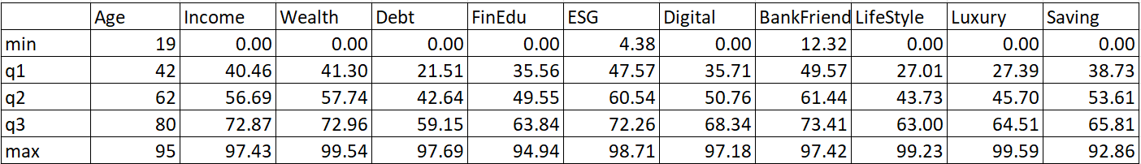
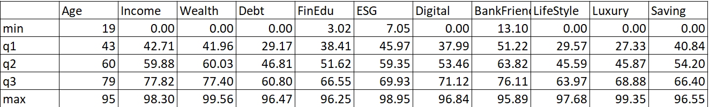
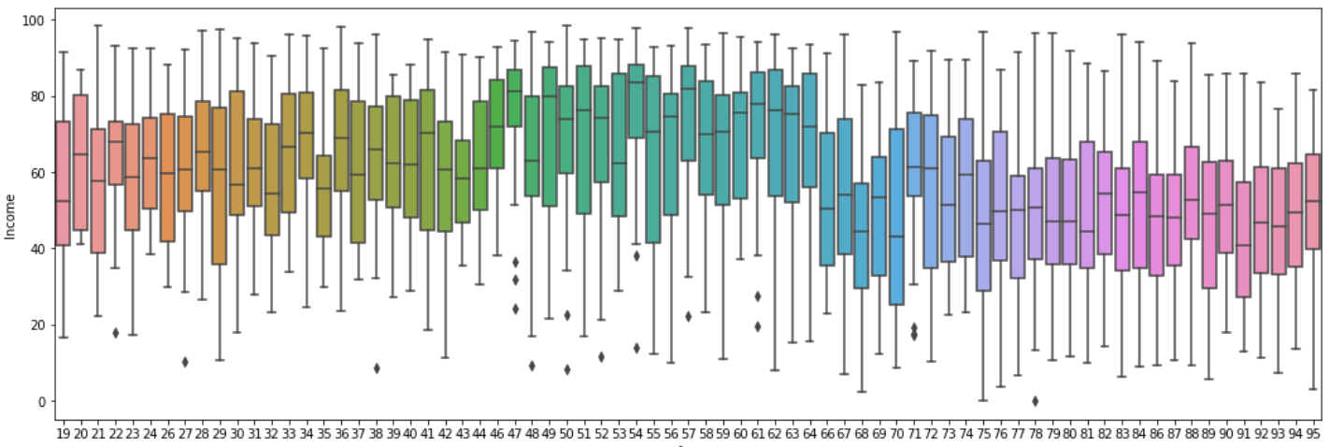
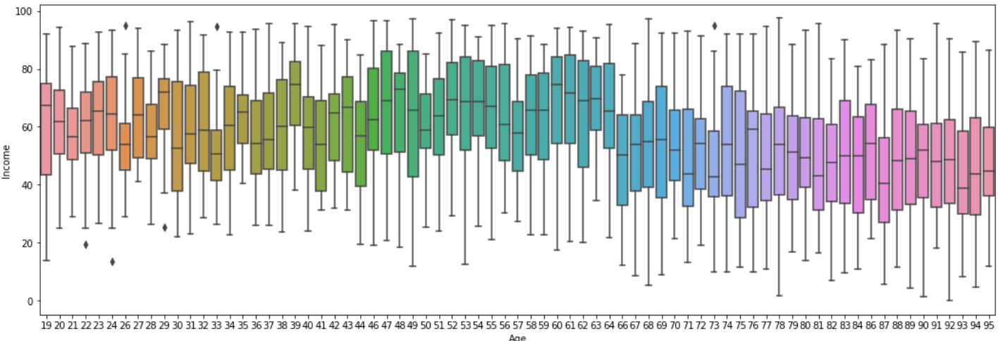
General statistics, division into subgroups.

Slide 6
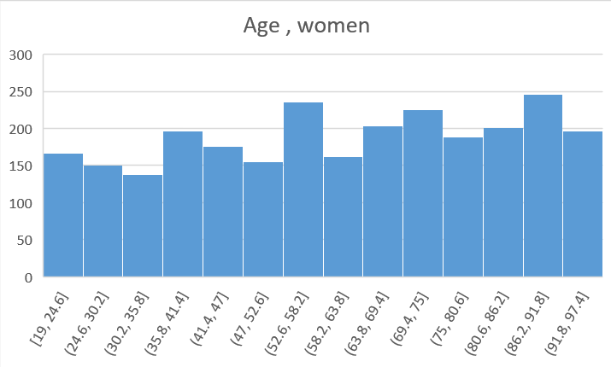
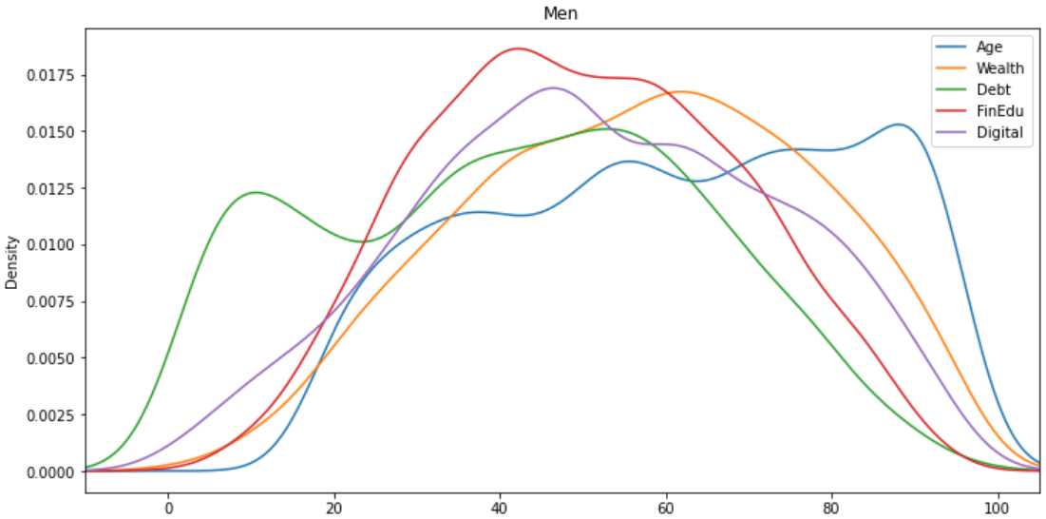
KDE plots,
Histograms,
Scatter plots

Slide 7
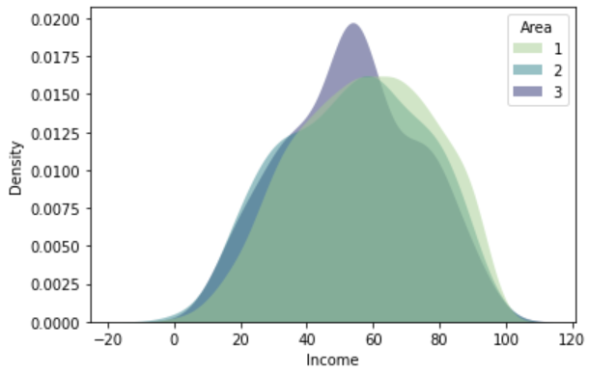
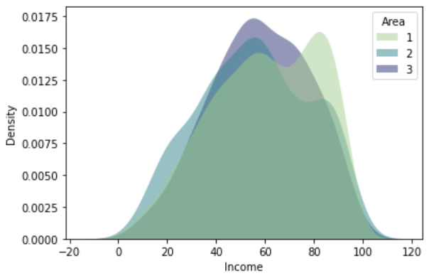
KDE plots,
Histograms,
Scatter plots

Slide 8
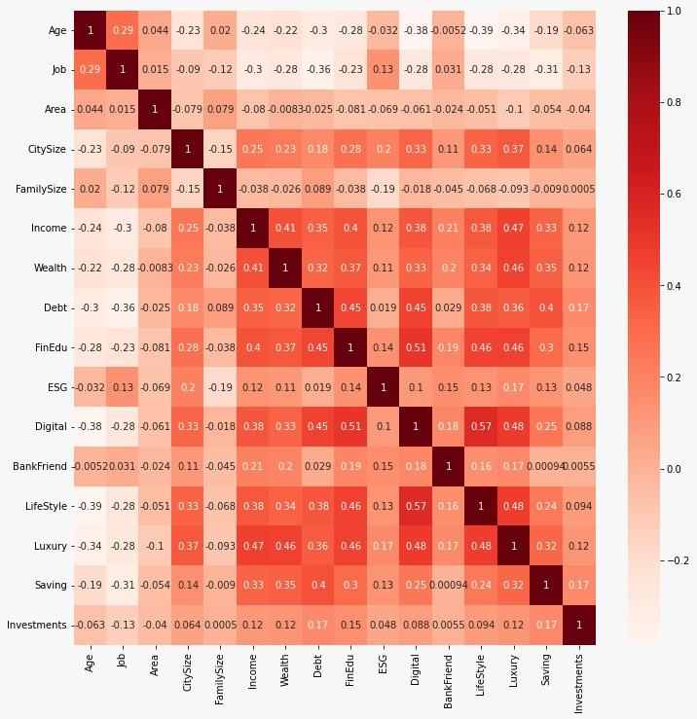
Correlation
Matrix

Slide 9
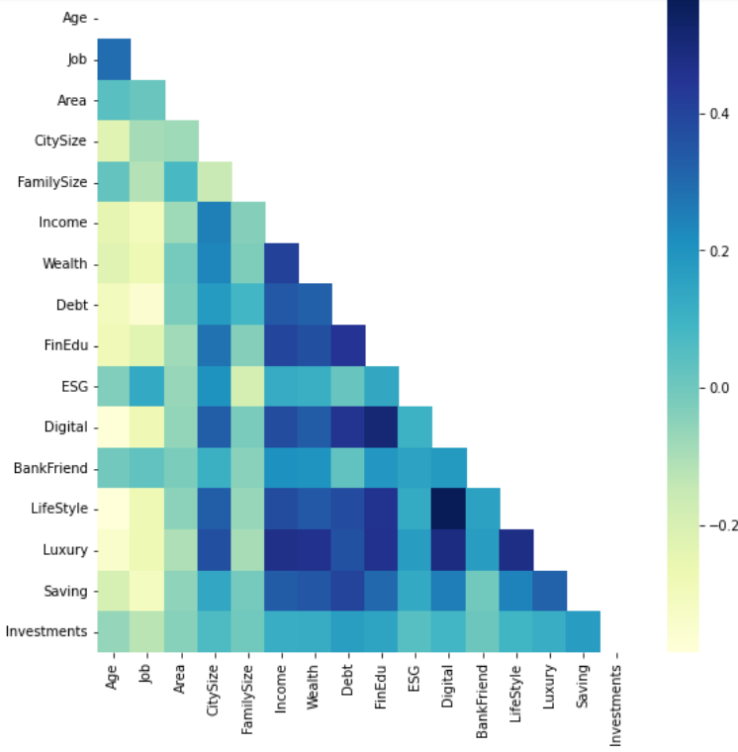
Correlation
Matrix

Slide 10
03
Data reduction: t-SNE

Slide 11
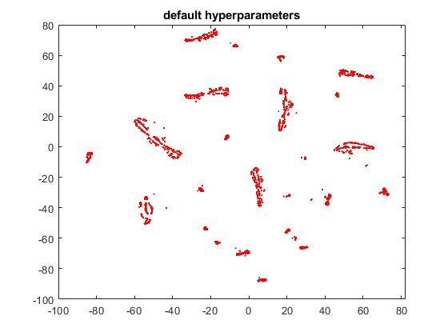
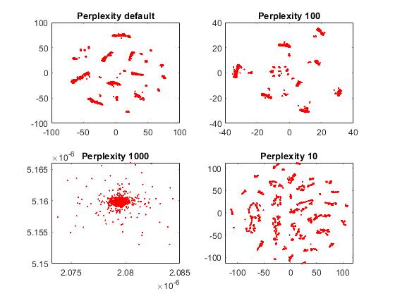
Data Exploration: t-SNE
Modifiable hyperparameters:
PERPLEXITY
EXAGGERATION
LEARNING RATE
Perplexity
A value which says how to balance attention between local and global aspects of your data.
The parameter is, in a sense, a guess about the number of close neighbors each point has.
We observe a tendency towards clearer shapes as the perplexity value increases.

Slide 12
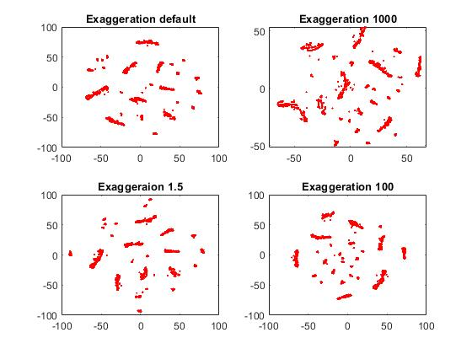
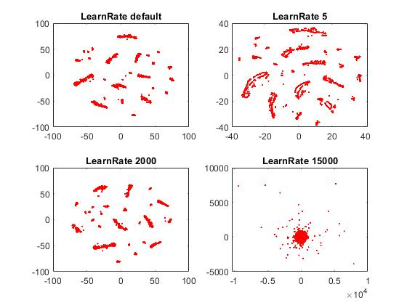
Exaggeration
This factor increases the attractive forces between points and allows points to move around more freely, finding their nearest neighbors more easily.
Learning Rate
The learning rate controls the step size of the gradient updates.
High LR - the data may look like a ‘ball’ with any point approximately equidistant from its nearest neighbours. Low LR - most points may look compressed in a dense cloud with few outliers.

Slide 13
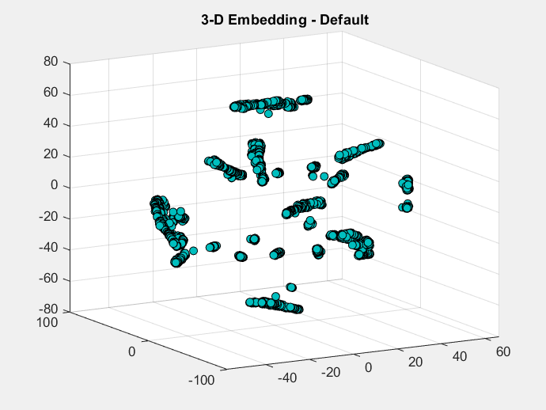
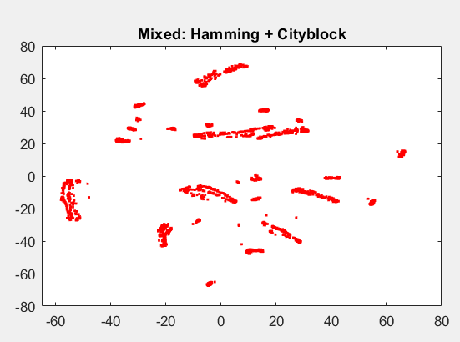
Distances
Our choices:
Hamming distances for categorical variables
L1 norm for numerical features
We combine them using relative weights in the function MixDistance.

Slide 14
04
Data reduction:
PCA

Slide 15
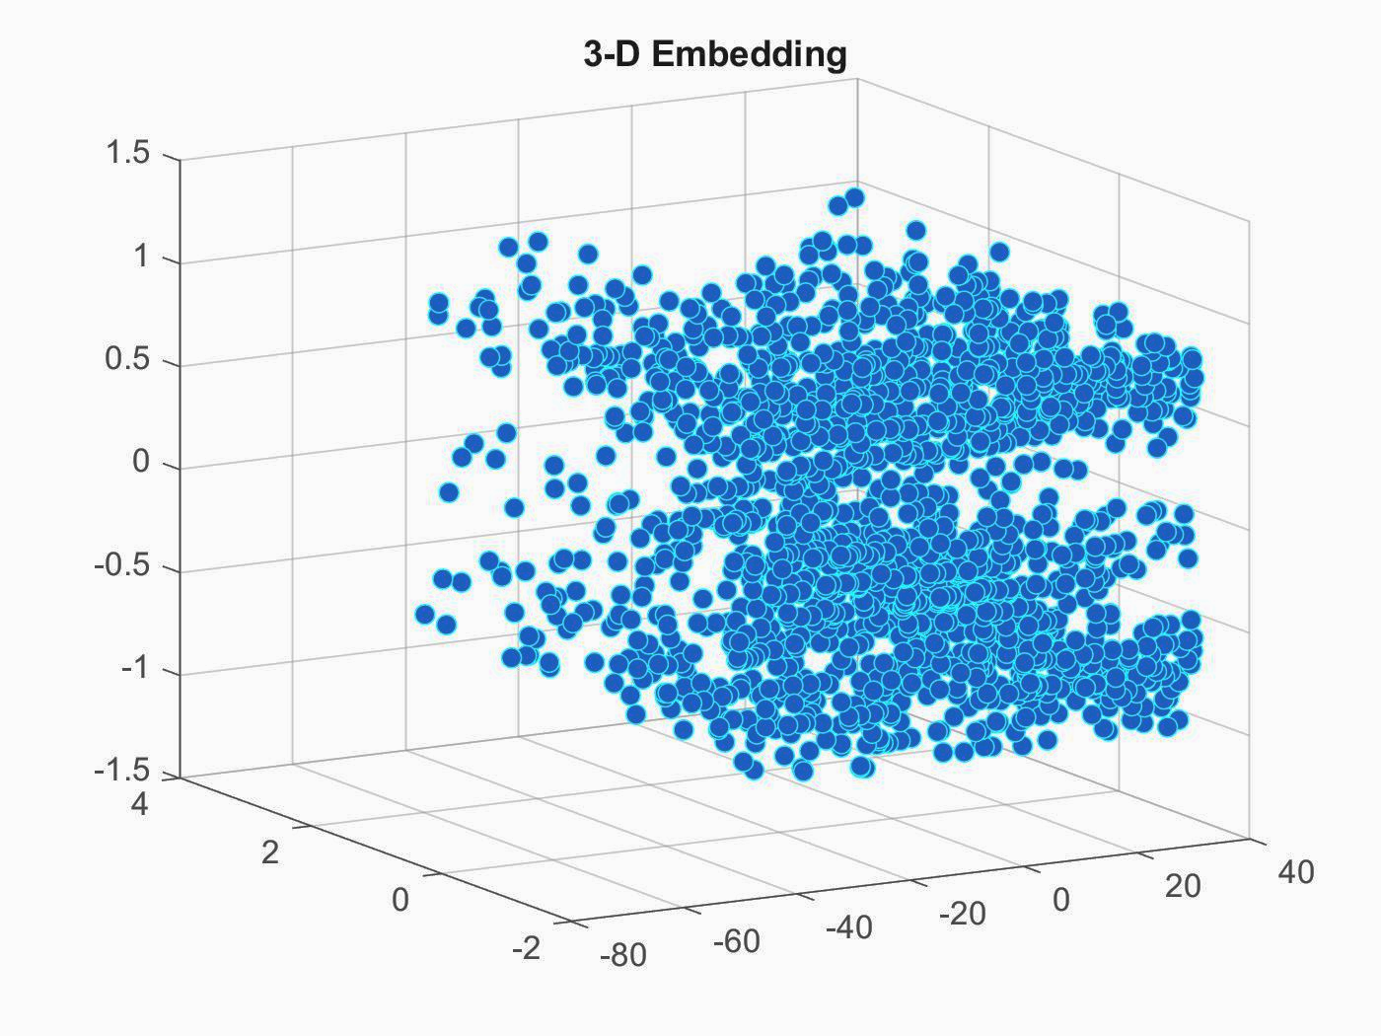
PCA
PCA 1
PCA 2
PCA 3
‘Normalized age’
‘Normalized Family size’
‘Dummy variables Gender, Job, City’

Slide 16
05
CLUSTERIZATION
K-medoids, DB-scan

Slide 17
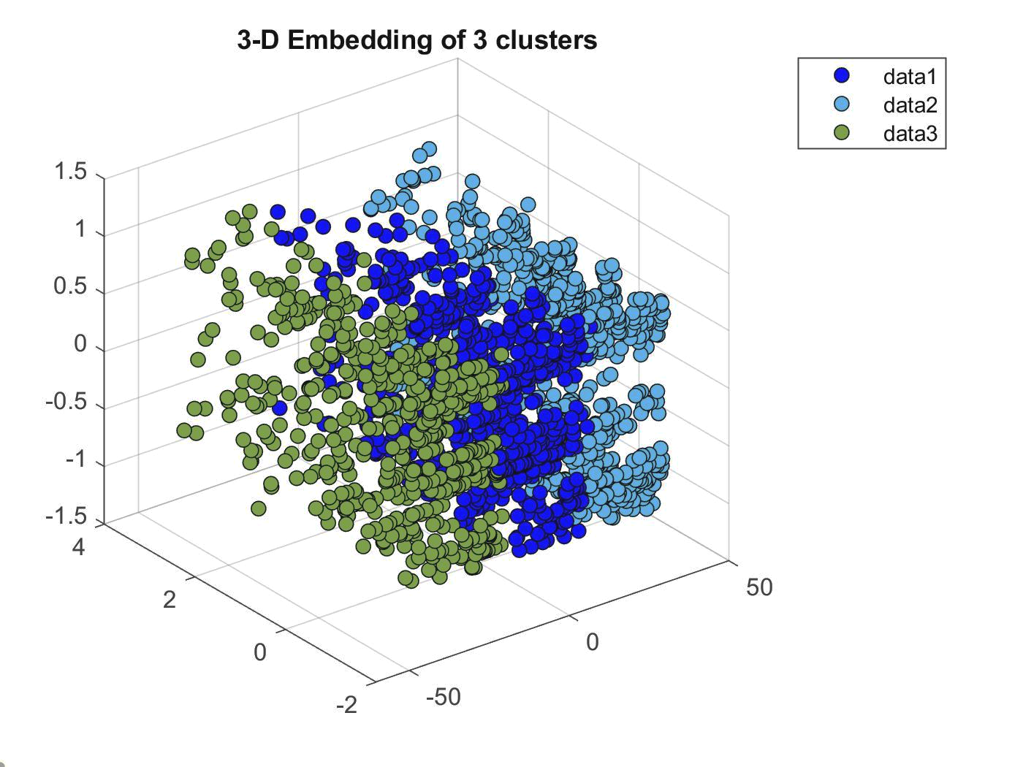
Clusterization (q-medoids)
3 clusters
Plot on the PCA axes
Best clusterization

Slide 18
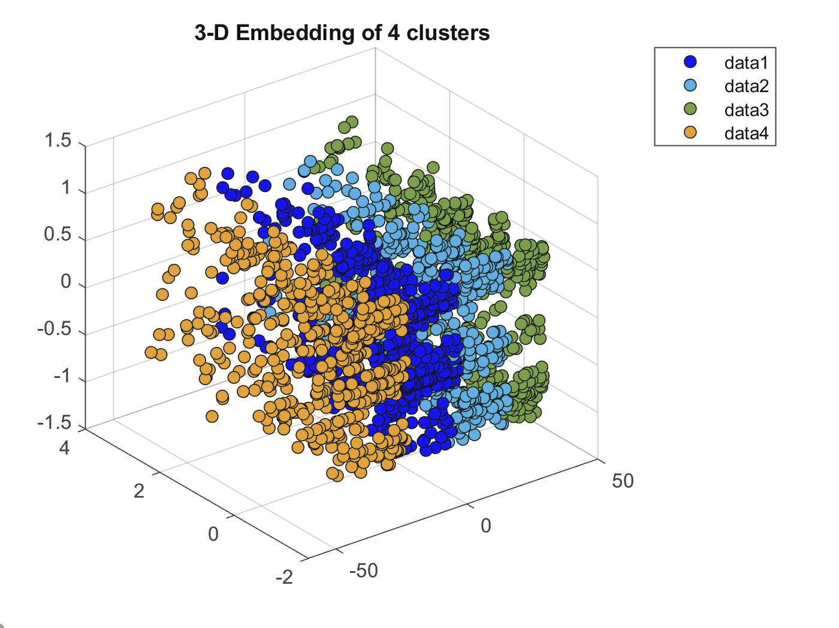
Clusterization (q-medoids)
4 clusters
Plot on the PCA axes
Two similar cluster:

Slide 19
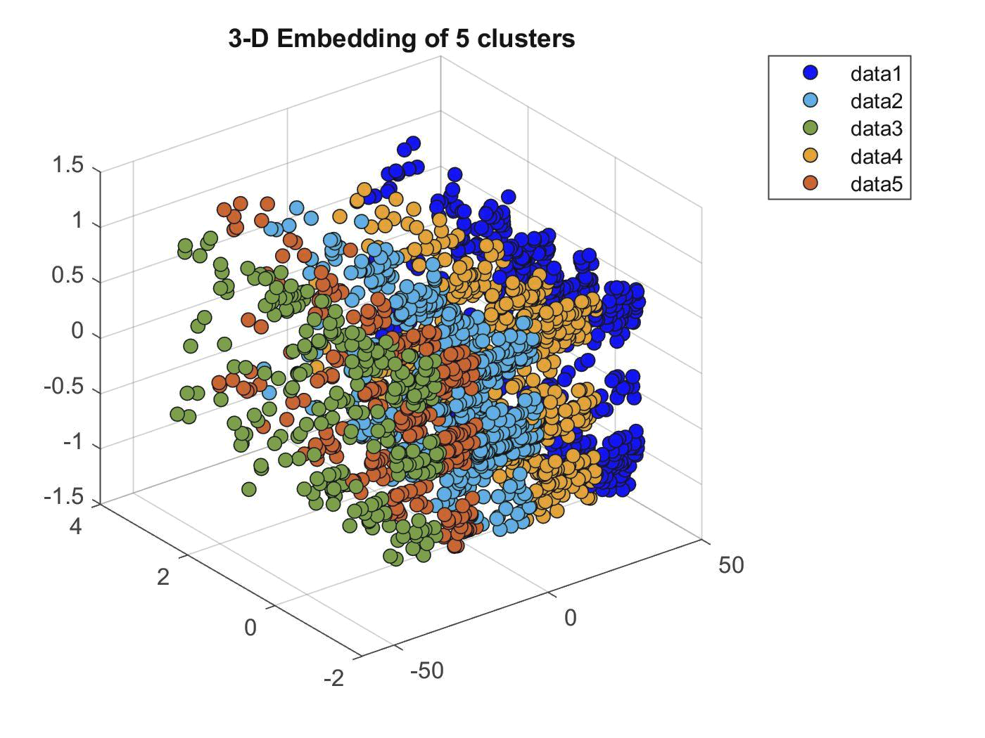
Clusterization (q-medoids)
5 clusters
Plot on the PCA axes
Caos

Slide 20
06
Clustering evaluation
Calinski-Harabasz Criterion, Davies-Bouldin criterion, Silhouette criterion

Slide 21
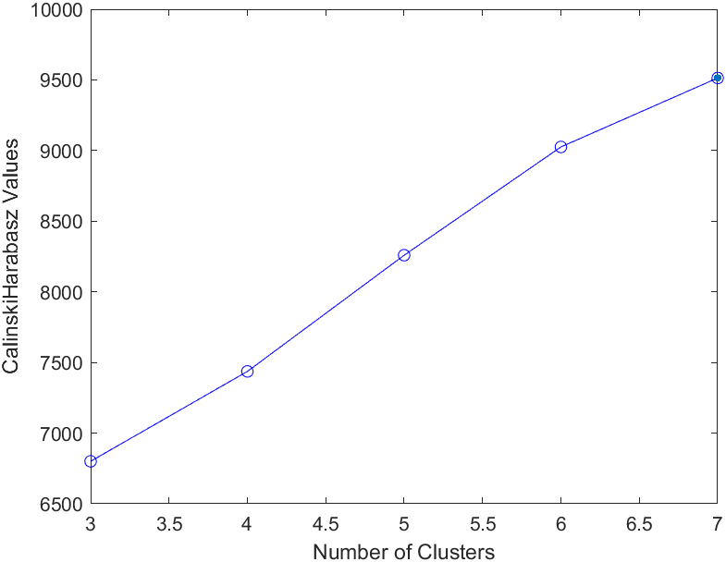
Calinski-Harabasz Criterion
Criterion values: [ 6.8005 7.4368 8.2592 9.0254 9.5135 ] e+03
Optimal k: 7

Slide 22
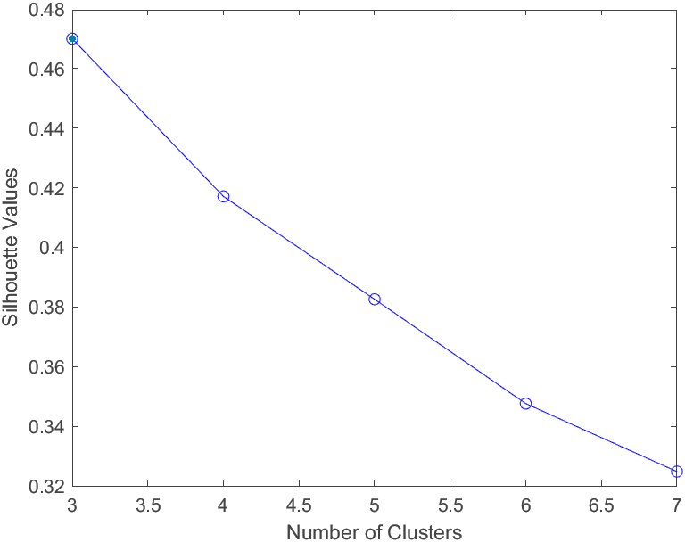
Silhouette evaluation
Criterion values: [0.4700 0.4171 0.3826 0.3248 ]
Optimal k: 3

Slide 23
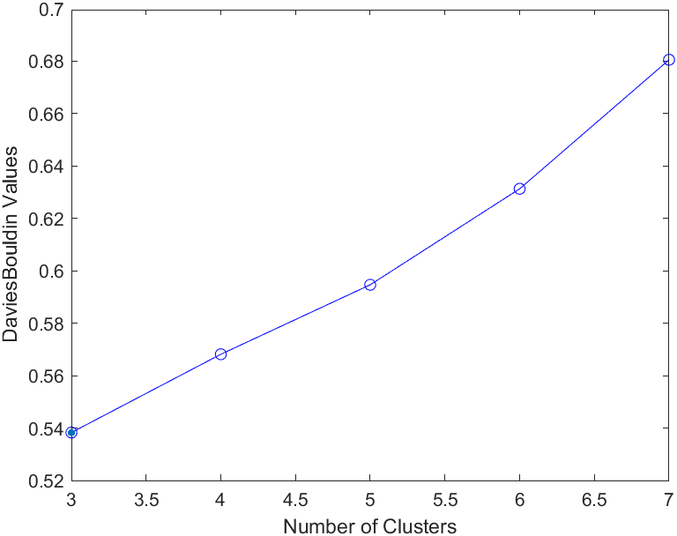
Davies- Bouldin criterion
Criterion values: [0.5383 0.5682 0.5947 0.6313 0.6806]
Optimal k : 3

Slide 24
07
INSIDE CLUSTERS
Creating personas

Slide 25
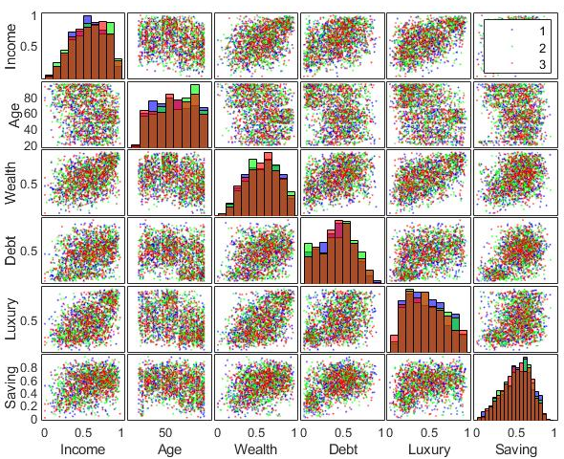
GplotMatrix: matrix of scatter plots

Slide 26
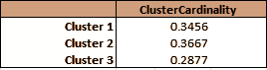
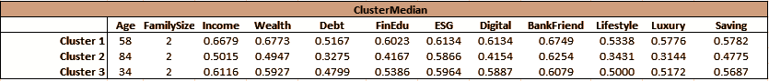
Cluster Cardinality and ClusterMedian: Numerical variables

Slide 27

Cluster 1:
Gen X
Characteristics:
Middle-age people
Higher value of income, wealth and savings
Higher debt
More financially educated and very BankFriendly

Slide 28

Cluster 2: boomers
Characteristics:
Old people, retired
Low digital propension
Lower income and debts
Not financially educated

Slide 29

Cluster 3:
Gen Y
Characteristics:
Young adults
High values of income
Bank friendly
Environmentally friendly
High digital propension
Tend to have many savings

Slide 30

THANK YOU!
@rizzombody @angelicaiacovelli
@lucreziamarcosignori
@jef.rey.news
@alessandrofrabetti

